Slide 1
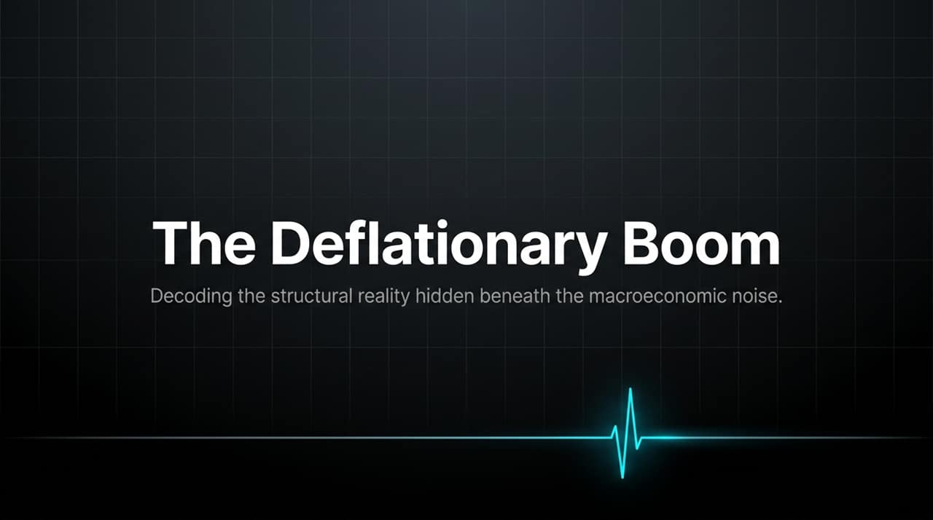
Notes:
Welcome, everyone. Today, we’re going to dive into what we consider one of the most misunderstood macroeconomic environments in recent history.
While headline news and financial commentary continue to obsess over inflation scares, rate hikes, and weak headline data, beneath the surface lies a powerful structural engine: The Deflationary Boom.
Over the next 15 slides, we will unpack how technological leverage—specifically AI inference collapse, demographic shifts in labor, and aggressive capital expenditure—is driving good deflation, boosting productivity, and resetting corporate margins for a secular expansion.
https://www.youtube.com/watch?v=COmxq7bh-fM

Slide 2
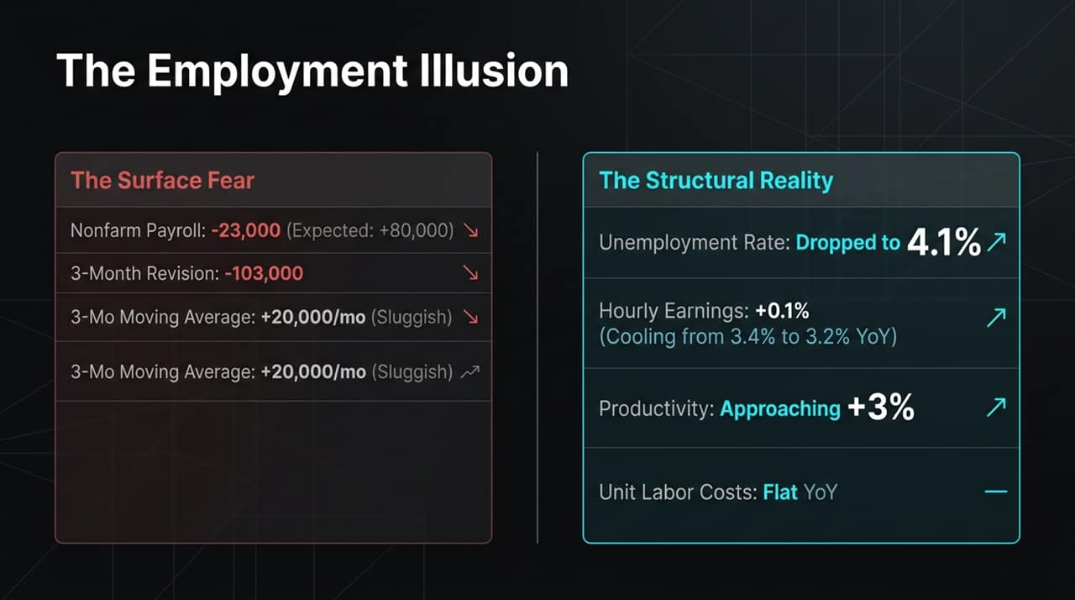
Notes:
Let's start by looking at the headline labor data that has spooked the markets. Nonfarm payrolls recently surprised to the downside, contracting by 23,000 versus an expected +80,000 gain. On top of that, prior months were revised down by 103,000, bringing the three-month moving average down to a sluggish +20,000 jobs per month.
On the surface, this looks like a weakening labor market. But when you parse through the internal mechanics, you find structural health.
First, the unemployment rate actually dropped to 4.1%. Second, wage growth is cooling in a controlled manner—average hourly earnings rose just 0.1% month-over-month, bringing the YoY rate down from 3.4% to 3.2%.
Crucially, US productivity growth is approaching 3%. With productivity keeping pace with earnings growth, unit labor costs are flat YoY. This means wage gains are being offset by efficiency rather than driving consumer inflation.

Slide 3
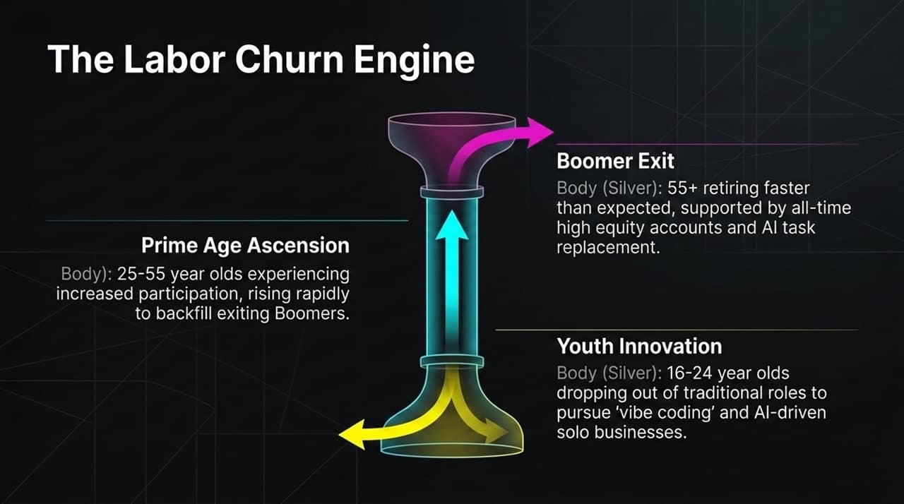
Notes:
Why are overall job numbers dropping while unemployment remains low? It comes down to a significant demographic labor churn across three key cohorts:
1. Boomer Exit (55+): Baby Boomers are retiring at an accelerated pace. Supported by record-high equity accounts, many are choosing to exit early rather than navigate AI task integration.
2. Prime-Age Ascension (25–55): Participation among 25-to-55-year-olds is rising rapidly to backfill vacancies left by exiting Boomers, opening fast-track career mobility.
3. Youth Innovation (16–24): Younger cohorts are opting out of traditional entry-level jobs. Enabled by accessible AI tools, they are pursuing 'vibe coding' and building solo businesses. They drop out of traditional employment rolls temporarily, but they represent an upcoming entrepreneurial wave.

Slide 4
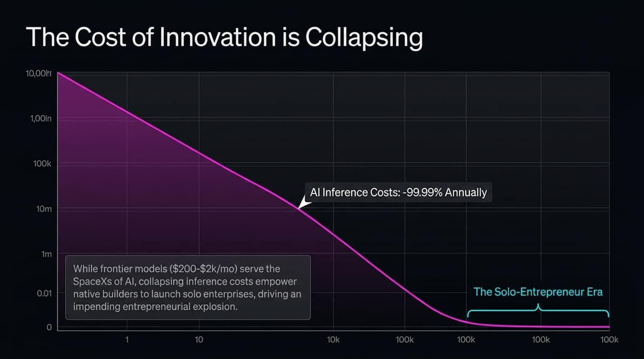
Notes:
This chart illustrates the core catalyst of the current tech paradigm: AI inference costs are collapsing by 99.99% annually.
While frontier models costing $200 to $2,000/month serve enterprise heavyweights, falling API and compute costs mean small teams and solo founders can run high-capability AI workflows for pennies.
We are entering the Solo-Entrepreneur Era. Tasks that previously required an entire G&A department—software design, deck generation, legal drafting—can now be executed by a single individual utilizing AI leverage.

Slide 5
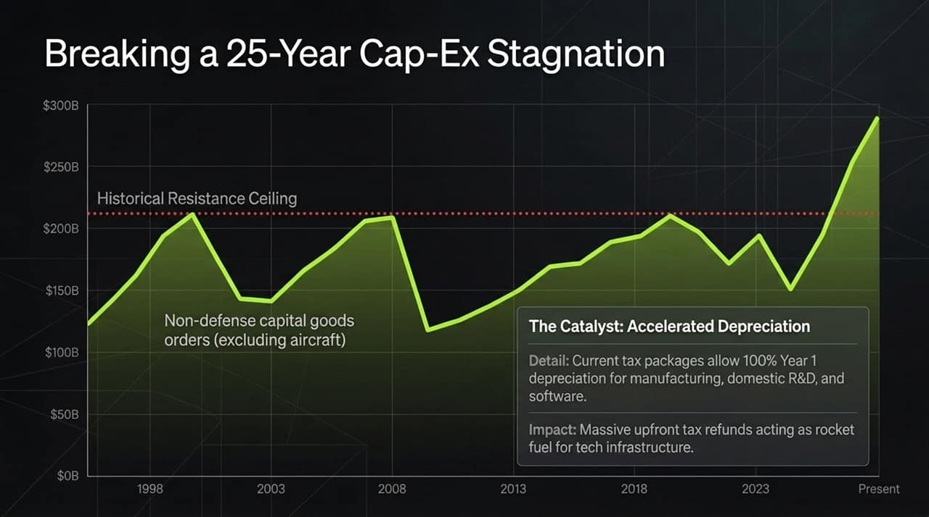
Notes:
From 1998 through 2022, non-defense capital goods orders remained capped below a historical resistance ceiling of ~$200 Billion. Companies were hesitant to deploy aggressive capital into long-term infrastructure.
Today, that 25-year ceiling has officially broken.
What is driving this breakout? Beyond the AI compute race, tax policy is providing significant tailwinds. Current fiscal packages allow 100% Year 1 accelerated depreciation for manufacturing facilities, domestic R&D, and software.
This creates massive upfront tax refunds for corporations, providing direct capital to fund digital and physical infrastructure.

Slide 6
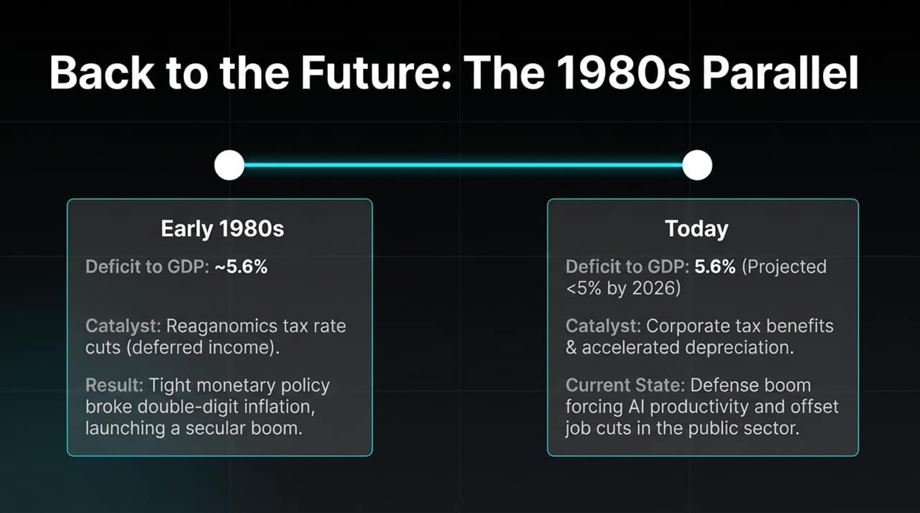
Notes:
We are seeing structural parallels between today's macroeconomic landscape and the early 1980s under Reaganomics.
In the early 1980s, the US had a deficit-to-GDP ratio near 5.6% following rate hikes to break double-digit inflation. Deferred income tax cuts initially caused friction, but ultimately launched a multi-decade economic boom.
Today, our deficit-to-GDP sits at 5.6% (projected to decline below 5%). Rather than inflationary fiscal strain, corporate tax benefits and accelerated depreciation are incentivizing high-ROI productivity investments, offsetting public-sector labor cuts and setting the stage for a long-term capital boom.

Slide 7
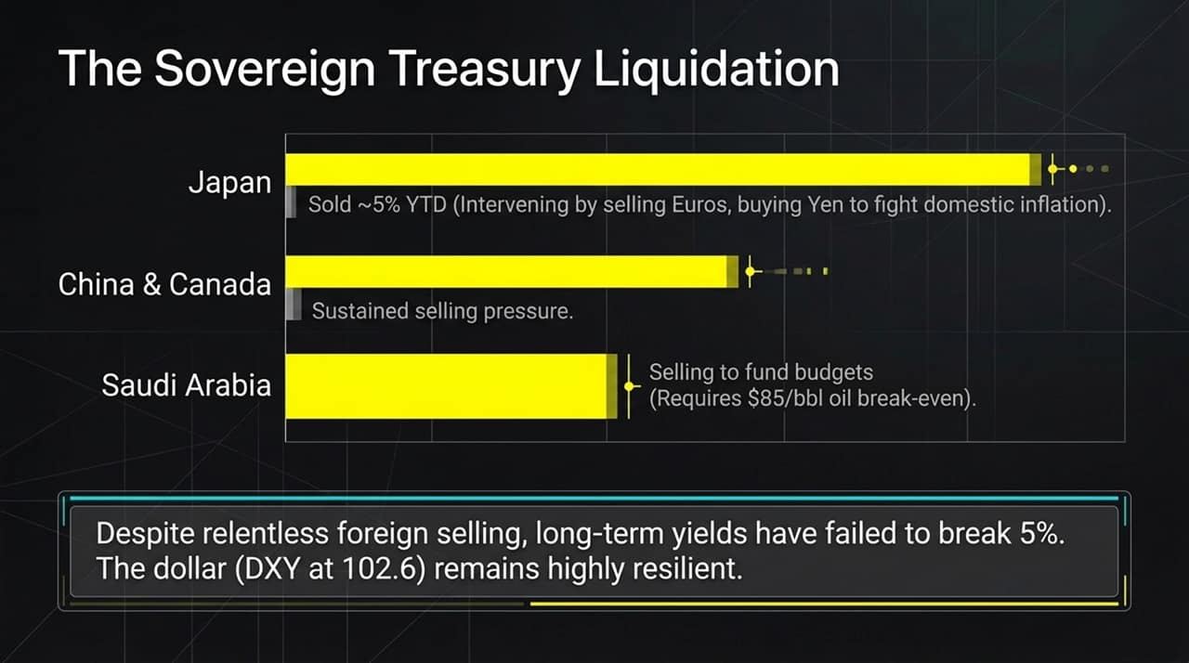
Notes:
A common bearish narrative is that global central banks are dumping US Treasuries, which will push long-term yields out of control and crash the Dollar.
Look at the actual mechanics: Japan sold ~5% YTD to defend the Yen via Euro sales; China and Canada have maintained selling pressure; Saudi Arabia is selling to cover budget deficits given current oil prices.
Despite this global Treasury liquidation, 10-year yields have consistently failed to break 5%, and the US Dollar index (DXY at 102.6) remains resilient. Global capital demand for US dollar assets continues to absorb foreign central bank selling.

Slide 8
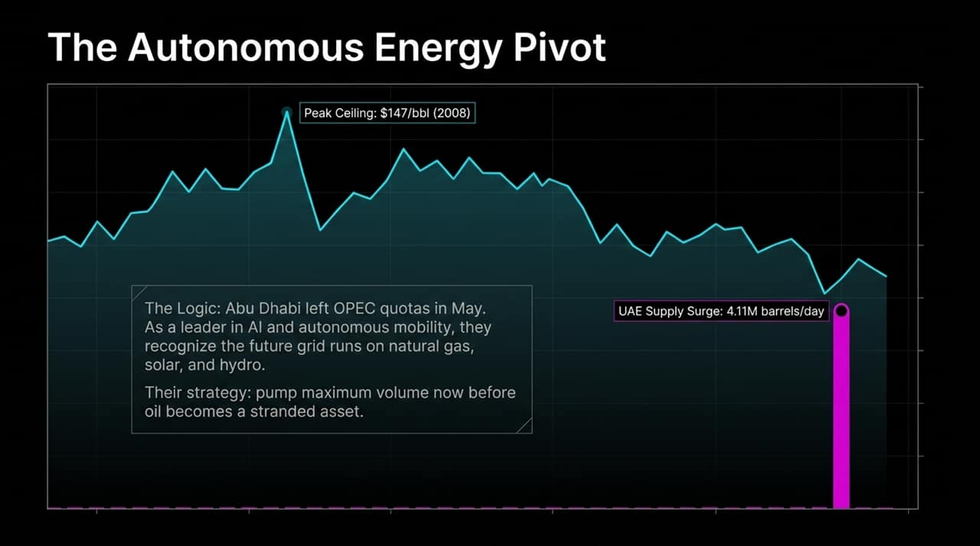
Notes:
Energy is another sector undergoing a structural shift. Oil prices peaked at $147/bbl in 2008 and have repeatedly failed to break higher, even amid geopolitical tension.
In May, Abu Dhabi (UAE) parted ways with OPEC production quotas, surging supply to 4.11 million barrels/day.
The strategic logic is straightforward: as leaders in AI and autonomous mobility, UAE leadership recognizes that the future energy grid will depend heavily on natural gas, solar, hydro, and renewables rather than crude oil. Their incentive is to maximize oil production now before oil risks becoming a stranded asset.

Slide 9
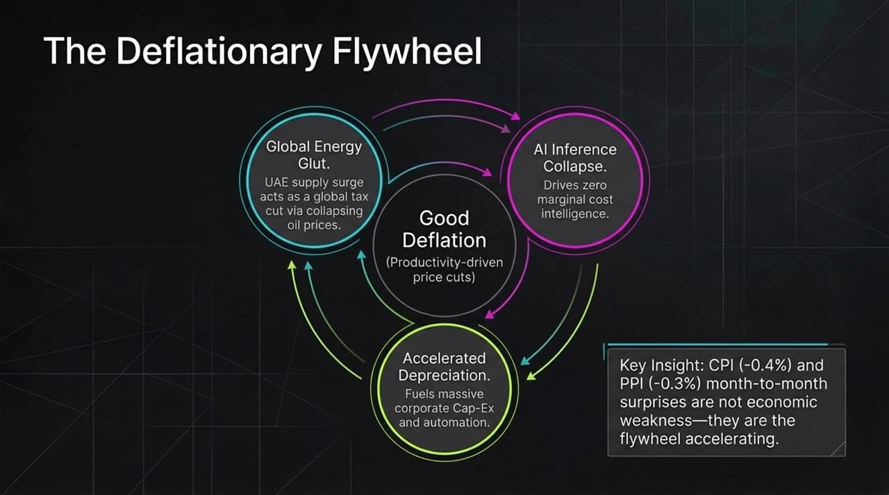
Notes:
Connecting these elements brings us to the core concept: The Deflationary Flywheel.
Three forces are acting together:"
Global Energy Glut: Surging oil/gas supply lowers input costs, acting like a tax cut for consumers and logistics.
AI Inference Collapse: Zero-marginal-cost intelligence reduces corporate software, development, and operational expenses.
Accelerated Depreciation: Fiscal incentives drive capital spending into high-efficiency automation.
When month-to-month CPI or PPI print negative (e.g., CPI -0.4%, PPI -0.3%), this is not demand-collapse recessionary deflation. This is Good Deflation—productivity-driven price reductions that expand corporate margins while improving consumer purchasing power.

Slide 10
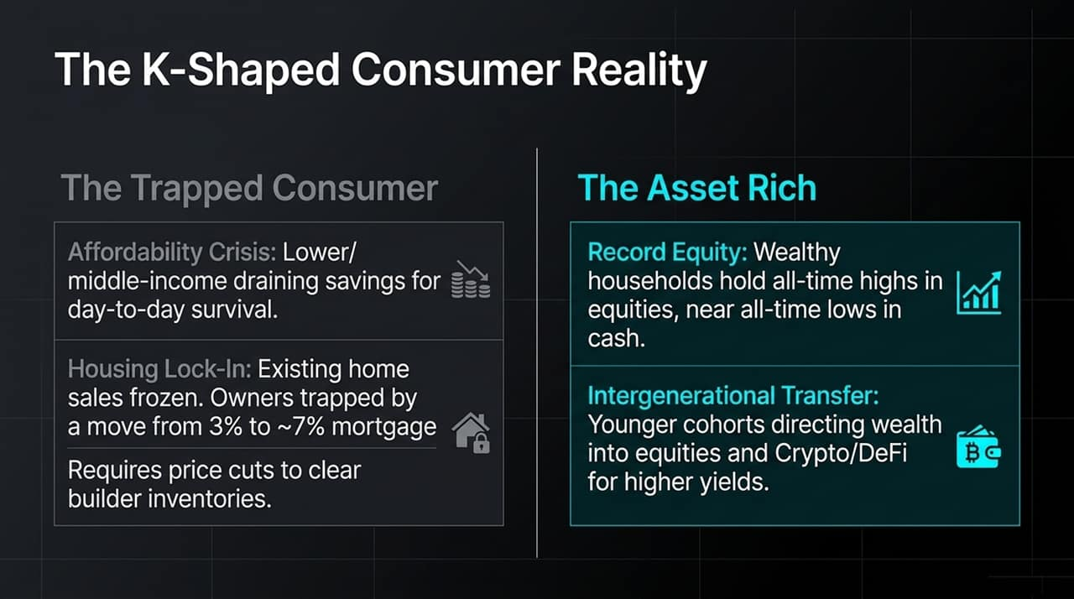
Notes:
While the macroeconomic backdrop is strong, consumer impact remains distinctly K-shaped:
On the lower branch is The Trapped Consumer. Lower and middle-income households are facing real affordability pressures, tapping savings for daily expenses. Housing is frozen because existing homeowners are locked into 3% mortgages while prevailing rates sit near 7%. Clearing builder inventories will require home price adjustments.
On the upper branch is The Asset Rich. Wealthier households hold all-time highs in equities with minimal cash allocations. Simultaneously, younger cohorts receiving intergenerational wealth transfers are putting capital directly into growth equities, crypto, and DeFi.

Slide 11
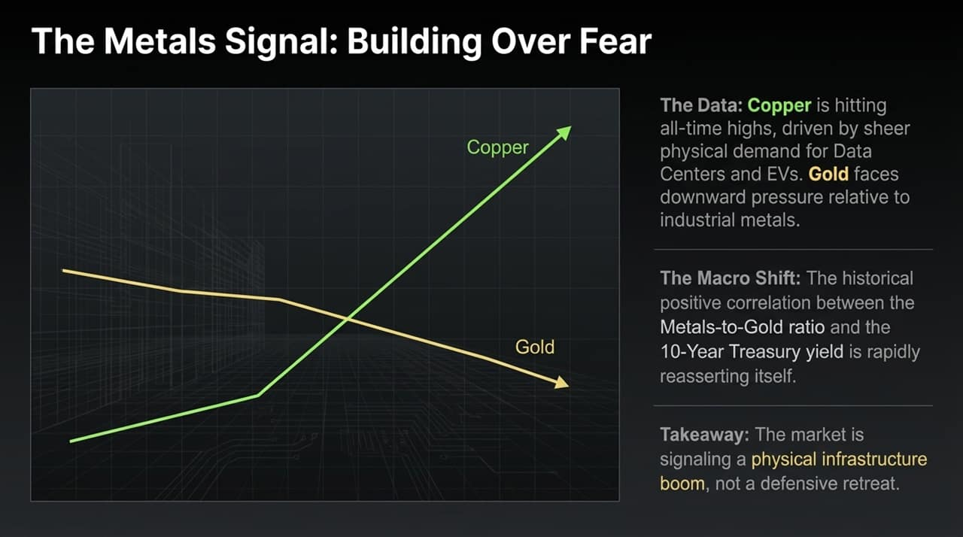
Notes:
The commodities market confirms this physical buildout. Copper is breaking out to all-time highs, driven by demand for data centers, grid electrification, and EVs.
At the same time, gold is seeing downward relative pressure as fear-driven safe-haven demand softens.
The historical positive correlation between the Metals-to-Gold ratio and Treasury yields is reasserting itself. The market is pricing in industrial infrastructure expansion rather than defensive hedging."

Slide 12
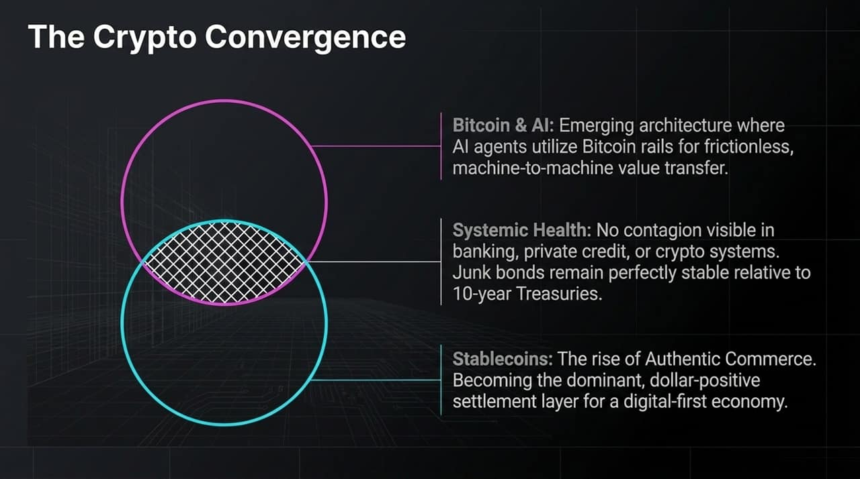
Notes:
Digital assets are playing an active role in this technological integration:"
1. Bitcoin & AI: Autonomous AI agents require permissionless, 24/7 value-settlement layers. Bitcoin provides a standard rail for machine-to-machine economic transactions.
2. Stablecoins: Stablecoins are becoming a primary settlement layer for global commerce, increasing net structural demand for short-duration US Treasuries.
3. Systemic Health: Credit indicators remain stable. High-yield junk bond spreads relative to the 10-Year Treasury show no systemic distress across banking, private credit, or digital asset markets."

Slide 13
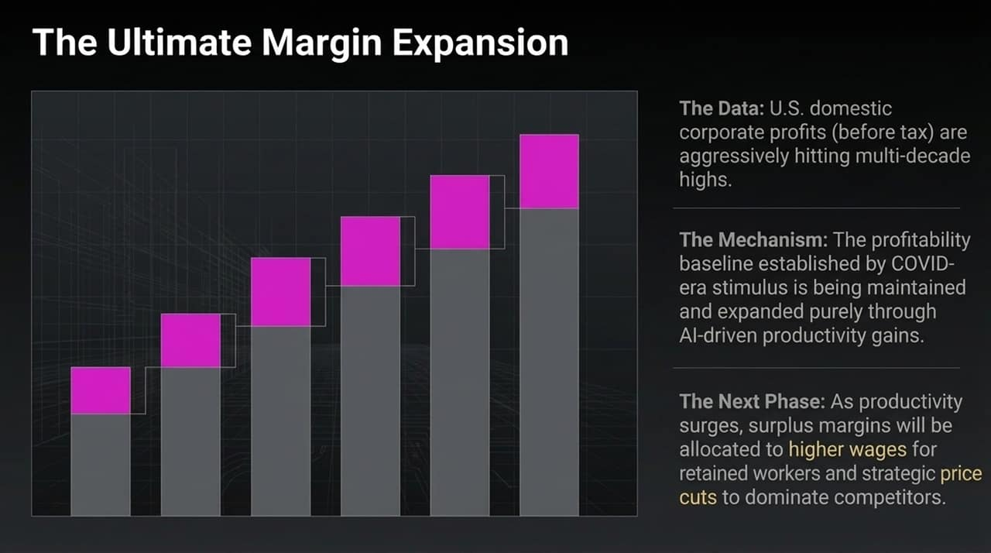
Notes:
US domestic corporate pre-tax profits are reaching multi-decade highs.
Following COVID-era stimulus, critics expected profit margins to mean-revert downward. Instead, companies have preserved and expanded these baselines through AI-driven productivity.
As efficiency increases, businesses can allocate surplus margins to retain key talent via higher compensation while selectively lowering end-user prices to gain market share.

Slide 14
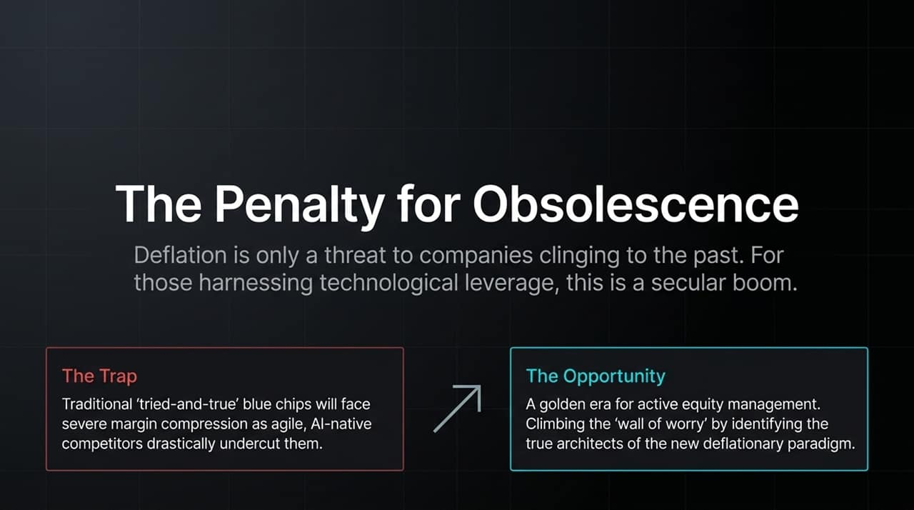
Notes:
Deflation is a tailwind for companies utilizing technology, but a threat to legacy operations.
The Trap: Traditional blue-chip companies with heavy legacy cost structures will face margin compression as agile, AI-native competitors offer similar products at a fraction of the cost.
The Opportunity: Passive index tracking may expose investors to legacy downside. Active management allows capital allocation toward the builders driving productivity-led deflation.

Slide 15
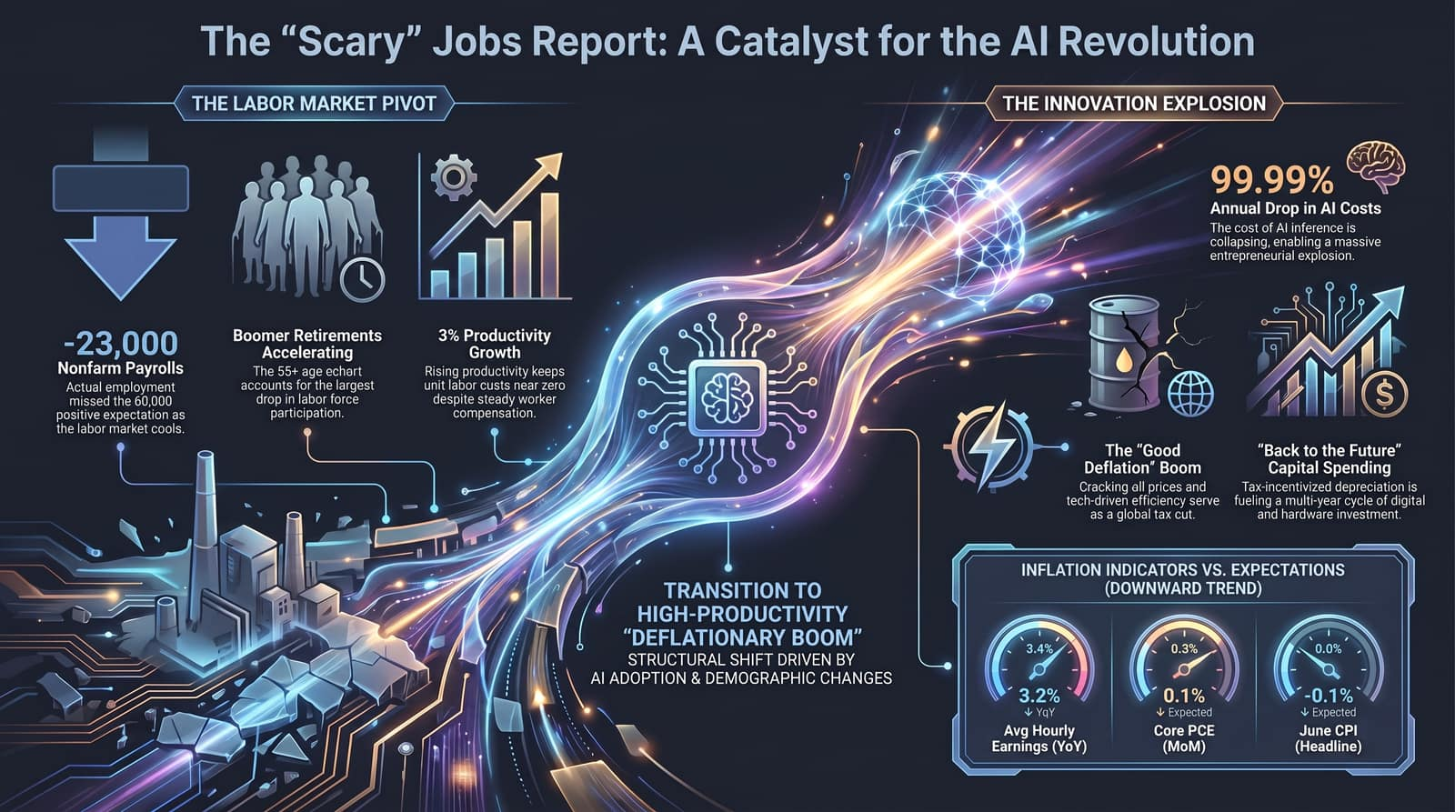
Notes:
To pull everything together, what initially appeared to be a 'scary' jobs report is actually a signal of a structural pivot.
1. Labor Pivot: -23,000 nonfarm payrolls reflect demographic retirement acceleration rather than economic collapse. 3% productivity growth keeps unit labor costs near zero.
2. Innovation & Cap-Ex: Collapsing AI inference costs (-99.99%) paired with tax-incentivized depreciation are fueling capital investment and solo entrepreneurship.
3. Inflation Trend: Lower input costs from energy and software efficiency are pushing inflation metrics downward in a controlled manner.
In short, we are transitioning from a high-cost, inflationary environment into a high-productivity Deflationary Boom.

